Slide 1
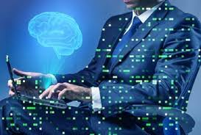
Introduction to Artificial Intelligence concept

Slide 2
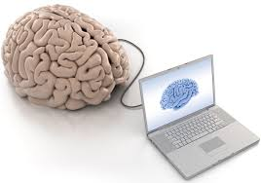
Definition
Artificial Intelligence (AI) is an approach to make a computer, a robot, or a product to think how smart human think.
AI is a study of how human brain think, learn, decide and work, when it tries to solve problems. And finally this study outputs intelligent software systems.

Slide 3
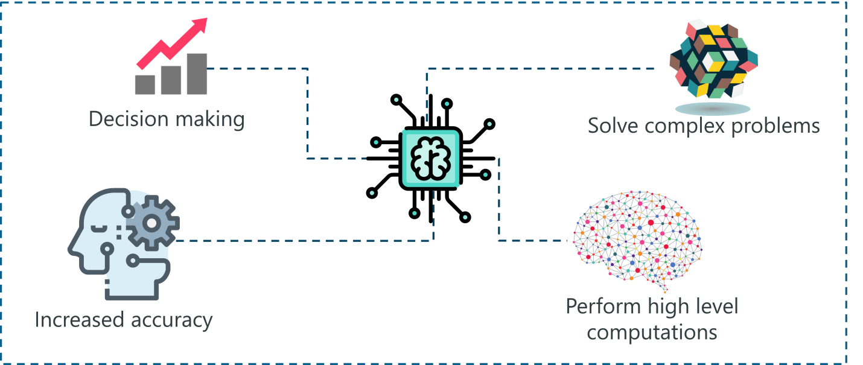
Contd..

Slide 4
Goals of AI
The aim of AI is to improve computer functions which are related to human knowledge, for example, reasoning, learning, and problem-solving.
The intelligence is composed of:
Reasoning: judgment, making decisions, and prediction.
Learning: Learning enhances the awareness of the subjects of the study.
Problem Solving: Applying logic with decision making concept.

Slide 5
Goals of AI (Continued)
Perception:
It is the process of acquiring, interpreting, selecting, and organizing sensory information.
Perception presumes sensing. In humans, perception is aided by sensory organs. In the domain of AI, perception mechanism puts the data acquired by the sensors together in a meaningful manner.
Linguistic Intelligence: It is one’s ability to use, comprehend, speak, and write the verbal and written language. It is important in interpersonal communication.

Slide 6
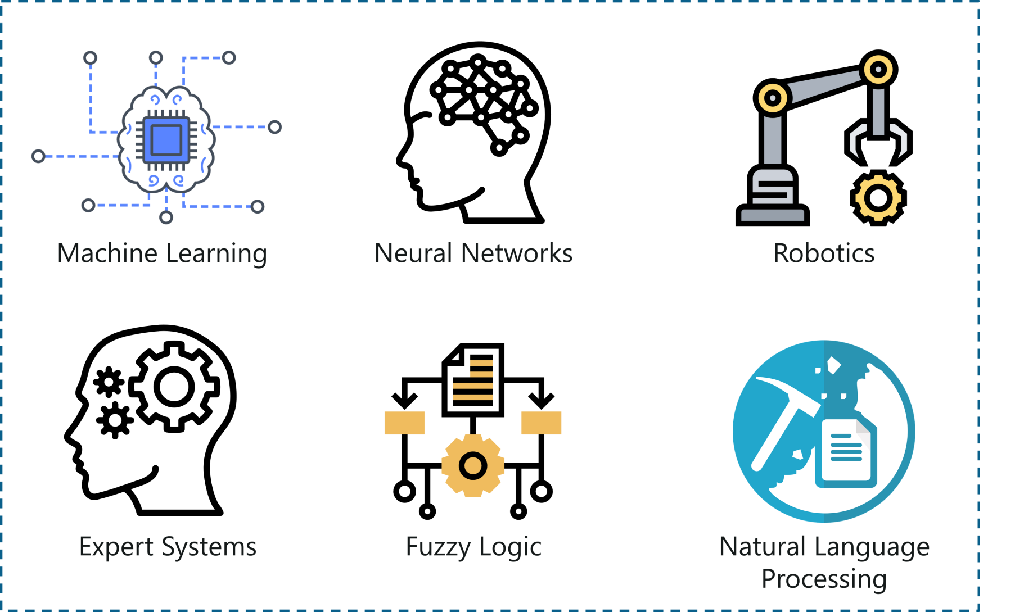
Branches of AI

Slide 7
Branches of AI
Robotics is a branch of AI, which is composed of Electrical Engineering, Mechanical Engineering, and Computer Science for designing, construction, and application of robots.
Natural Language Processing (NLP) refers to AI method of communicating with an intelligent systems using a natural language such as English.
Expert systems are the computer applications developed to solve complex problems in a particular domain, at the level of extra-ordinary human intelligence and expertise.

Slide 8
Branches of AI
Neural Networks: A computing system made up of a number of simple, highly interconnected processing elements, which process information by their dynamic state response to external inputs.
Fuzzy Logic Systems: Fuzzy Logic (FL) is a method of reasoning that resembles human reasoning. The approach of FL imitates the way of decision making in humans that involves all intermediate possibilities between digital values YES and NO.

Slide 9
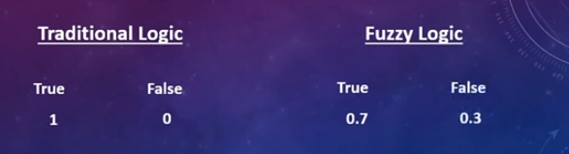
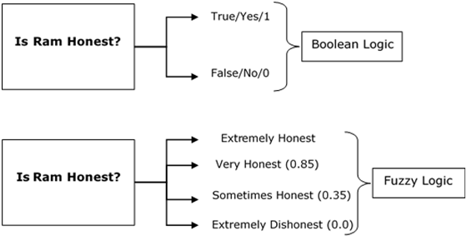

Slide 10
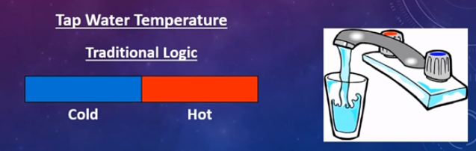
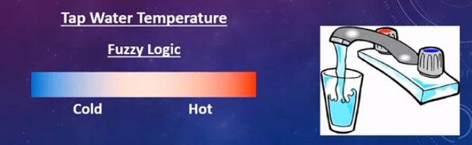

Slide 11
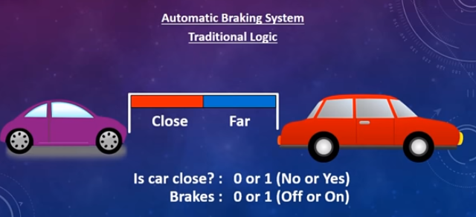
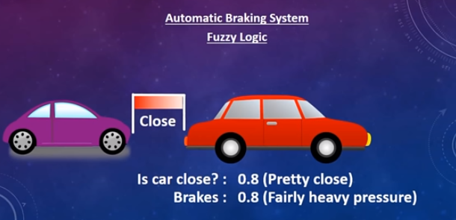

Slide 12
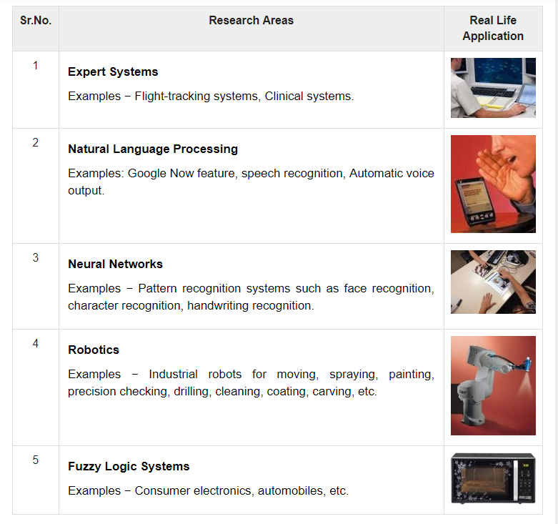
Branches of AI

Slide 13
Types of Learning
Supervised Learning
Unsupervised Learning
Reinforcement Learning

Slide 14
Supervised Learning
Supervised learning is a learning in which we train the machine using data which is well labeled that means some data is already tagged with the correct answer.
After that, the machine is provided with a new set of examples(data) so that supervised learning algorithm analyses the training data(set of training examples) and produces a correct outcome from labeled data.

Slide 15
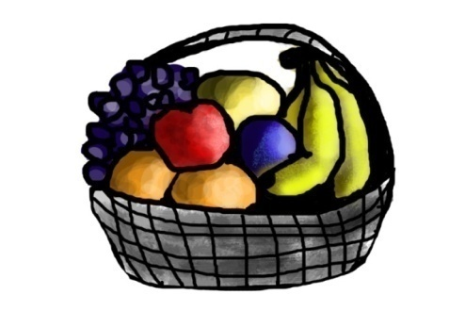
Contd..
Lets take example,
If shape of object is rounded and depression at top having color Red then it will be labelled as –Apple.
If shape of object is long curving cylinder having color Green-Yellow then it will be labelled as –Banana.

Slide 16

Contd..
After training the data, you have given a new separate fruit say Banana from basket and asked to identify it.
It will first classify the fruit with its shape and color and would confirm the fruit name as BANANA and put it in Banana category.

Slide 17
Contd..
Supervised learning is classified into two categories of algorithms:
Classification: A classification problem is when the output variable is a category, such as “Red” or “blue” or “disease” and “no disease”.
Regression: A regression problem is when the output variable is a real value, such as “dollars” or “weight”.

Slide 18
Unsupervised Learning
Unsupervised learning is the training of machine using information that is neither classified nor labeled and allowing the algorithm to act on that information without guidance.
The task of machine is to group unsorted information according to similarities, patterns and differences without any prior training of data.

Slide 19
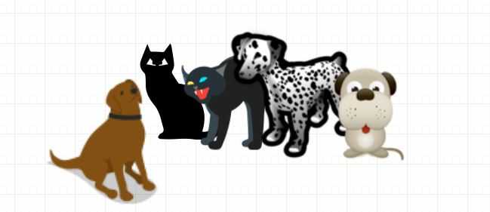
Contd..
It categorizes them according to their similarities, patterns, and differences i.e., we can easily categorize the above picture into two parts.
First part may contain all pics having dogs in it.
second part may contain all pics having cats in it.
Here you didn’t learn anything before, means no training data or examples.

Slide 20
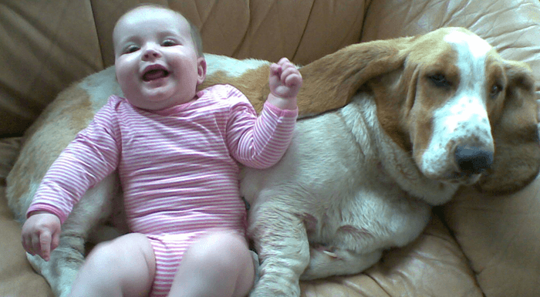
Let's, take the case of a baby and her family dog.

Slide 21
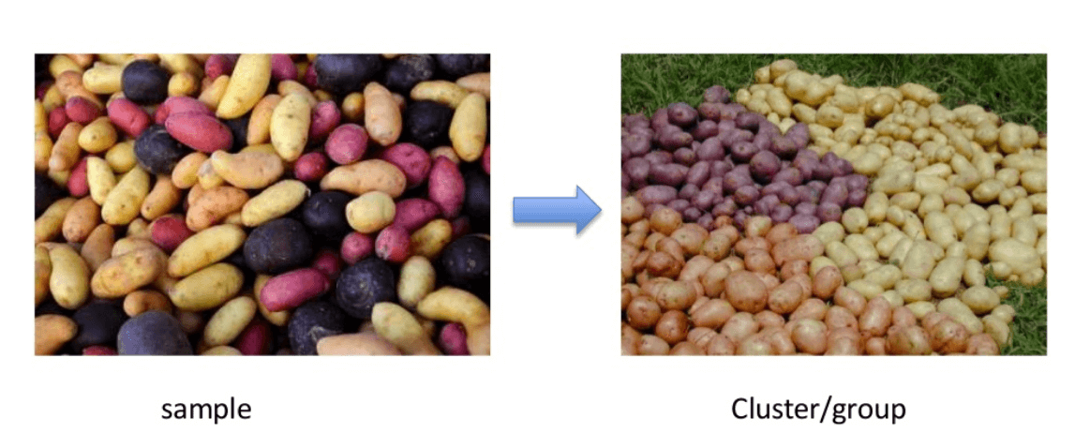
Contd..
Unsupervised learning is classified into two categories of algorithms:
Clustering: A clustering problem is where you want to discover the inherent groupings in the data, such as grouping customers by purchasing behavior.
The organization of unlabeled data into similarity groups called clusters.

Slide 22
Association: Association rules allow you to establish associations amongst data objects inside large databases. This unsupervised technique is about discovering interesting relationships between variables in large databases. For example, people that buy a new home most likely to buy new furniture.
Some examples
A subgroup of cancer patients grouped by their gene expression measurements.
Groups of shopper based on their browsing and purchasing histories.
Movie group by the rating given by movies viewers.

Slide 23
Reinforcement Learning
Reinforcement. It is about taking suitable action to maximize reward in a particular situation.
It allows machines and software agents to automatically determine the ideal behavior within a specific context, in order to maximize its performance.

Slide 24
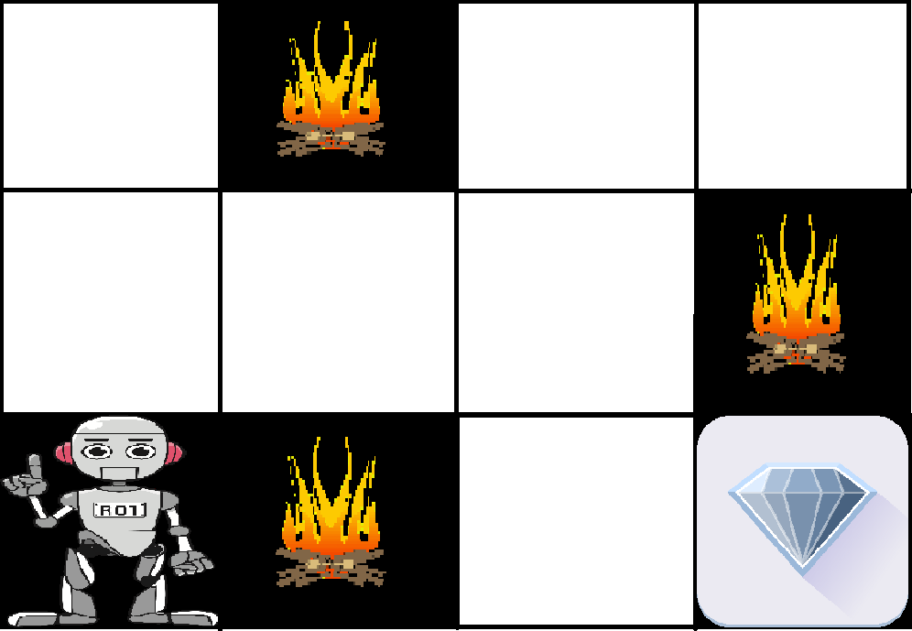
Contd..
Problem: We have an agent and a reward, with many hurdles in between. The agent is supposed to find the best possible path to reach the reward.

Slide 25
Contd..
Main points in Reinforcement learning
Input: The input should be an initial state from which the model will start.
Output: There are many possible outputs as there are variety of solution to a particular problem.
Training: The training is based upon the input. The model will return a state and the user will decide to reward or punish the model based on its output.
The model keeps continues to learn.
The best solution is decided based on the maximum reward.

Slide 26
Contd..
Two types of Reinforcement Learning are:
Positive: It is defined as when an event occurs due to a particular behavior, increases the strength and the frequency of the behavior.
Examples:
A mother gives her son praise (reinforcing stimulus) for doing homework (behavior).
The little boy receives $5.00 (reinforcing stimulus) for every A grade he earns on his report card (behavior).
A father gives his daughter candy (reinforcing stimulus) for cleaning up toys (behavior).
Negative: It is defined as strengthening of a behavior because a negative condition is stopped or avoided
Example:
Bob does the dishes (behavior) in order to stop his mother’s nagging (aversive stimulus).

Slide 27
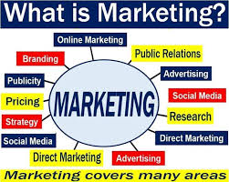
APPLICATION OF AI
MARKETING

Slide 28
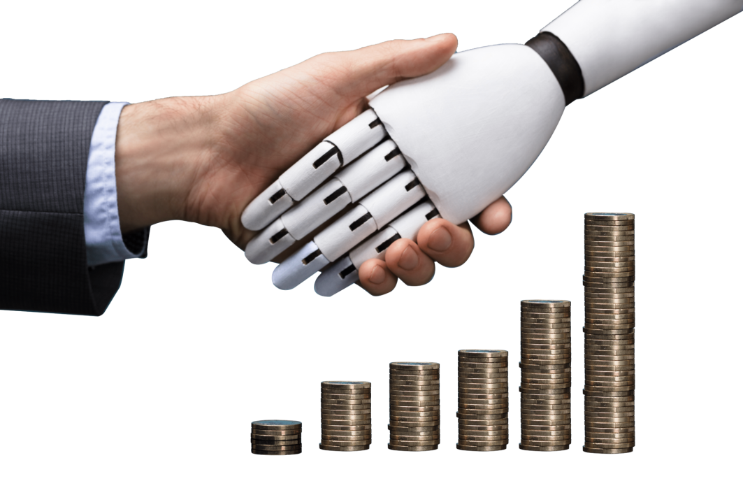

BANKING
HDFC Bank has developed an AI-based chatbot called EVA (Electronic Virtual Assistant), built by Bengaluru-based Senseforth AI Research.
-3 million customer queries
-Eva can collect knowledge from thousands of sources and provide simple answers in less than 0.4 seconds.

Slide 29
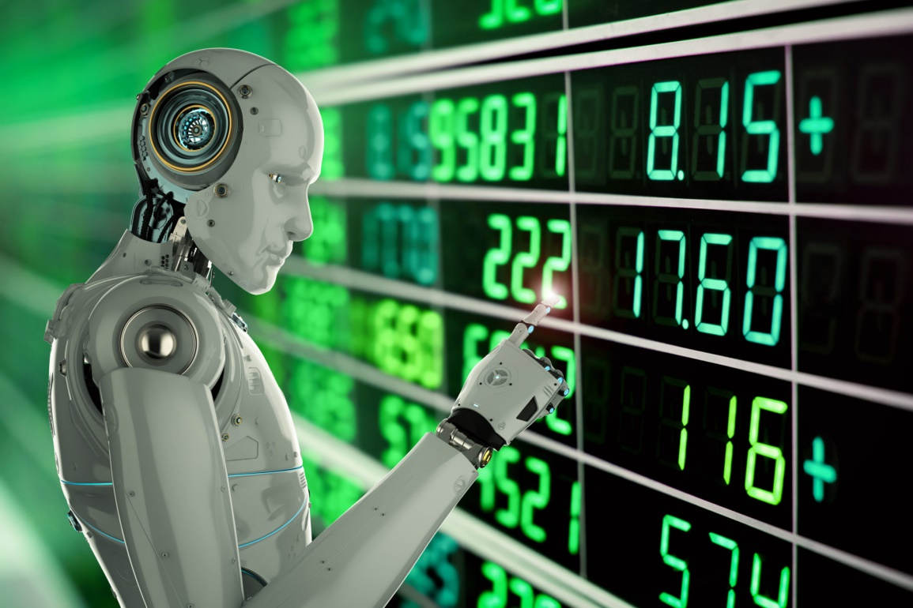
Finance
Ventures have been relying on computers and data scientists to determine future patterns in the market. Trading mainly depends on the ability to predict the future accurately.

Slide 30
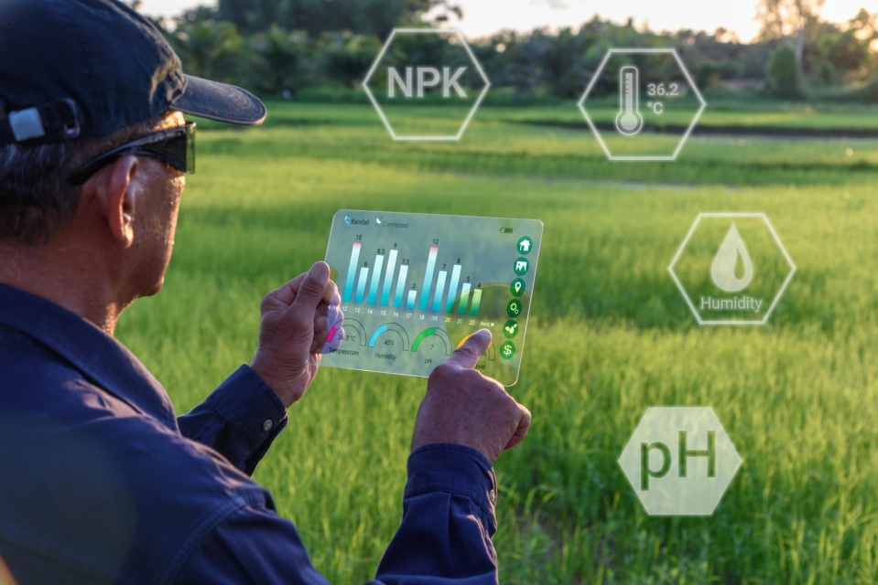
AGRICULTURE
Blue River Technology has developed a robot called See & Spray which uses computer vision technologies like object detection to monitor and precisely spray weedicide on cotton plants. Precision spraying can help prevent herbicide resistance.
Berlin-based agricultural tech start-up called PEAT, has developed an application called Plantix that identifies potential defects and nutrient deficiencies in the soil through images.

Slide 31
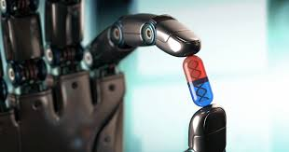
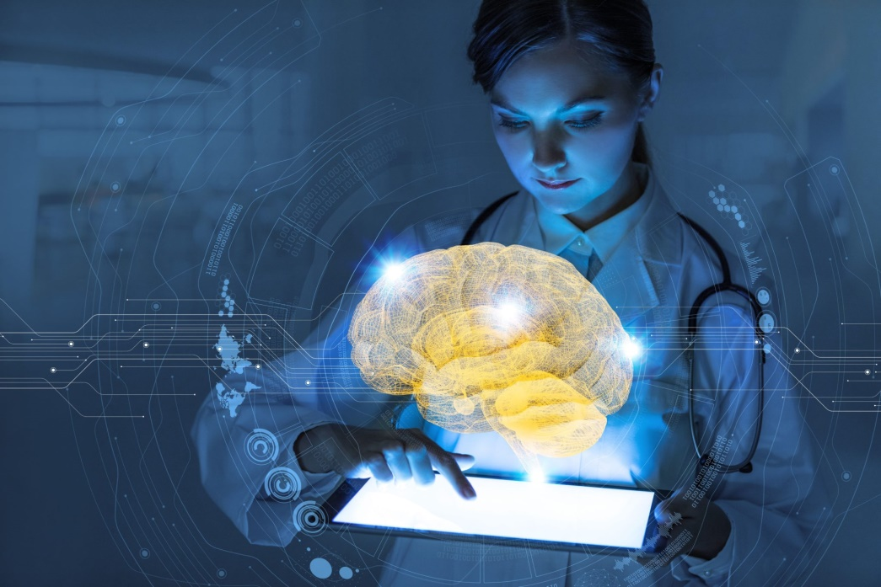
Health Care
-An organization called Cambio Health Care developed a clinical decision support system for stroke prevention that can give the physician a warning when there’s a patient at risk of having a heart stroke.
-Similarly, Aifloo is developing a system for keeping track of how people are doing in nursing homes, home care, etc.

Slide 32
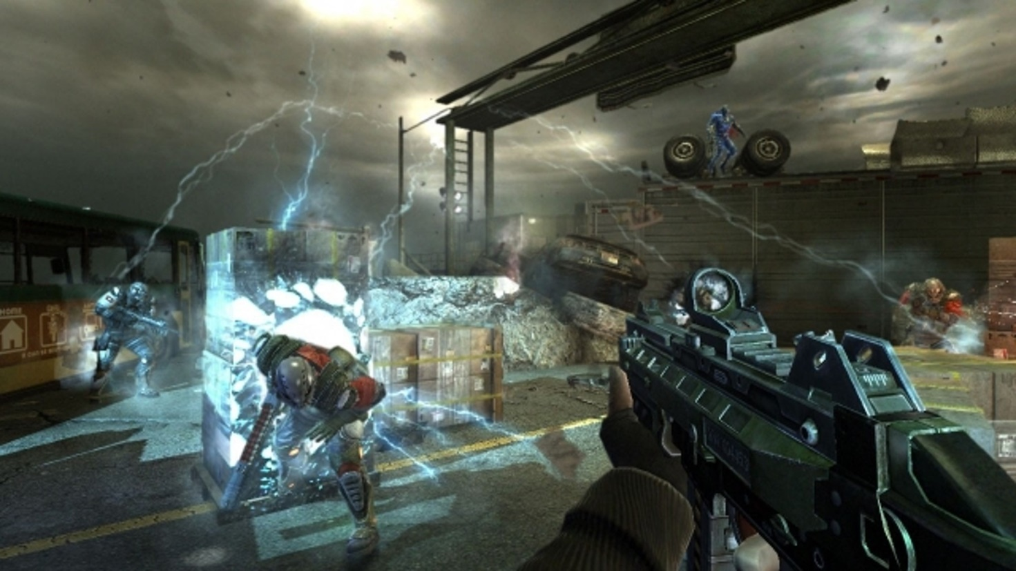
Gaming
The actions taken by the opponent AI are unpredictable because the game is designed in such a way that the opponents are trained throughout the game and never repeat the same mistakes. They get better as the game gets harder. This makes the game very challenging and prompts the players to constantly switch strategies and never sit in the same position.

Slide 33
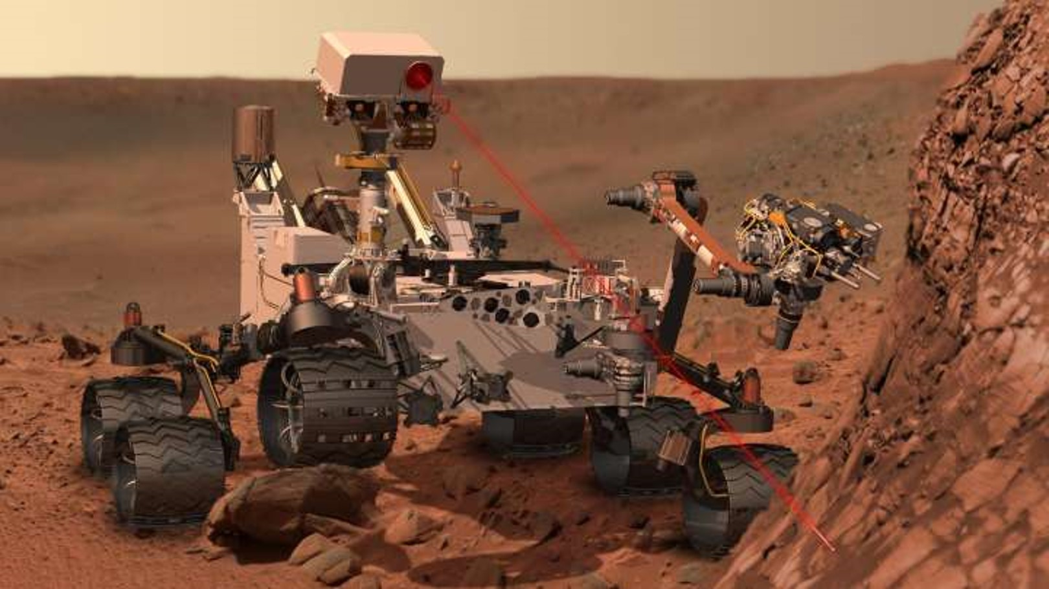
Space Exploration
Artificial Intelligence is also being used for NASA’s next rover mission to Mars, the Mars 2020 Rover. The rover is responsible for autonomous targeting of cameras in order to perform investigations on Mars.

Slide 34
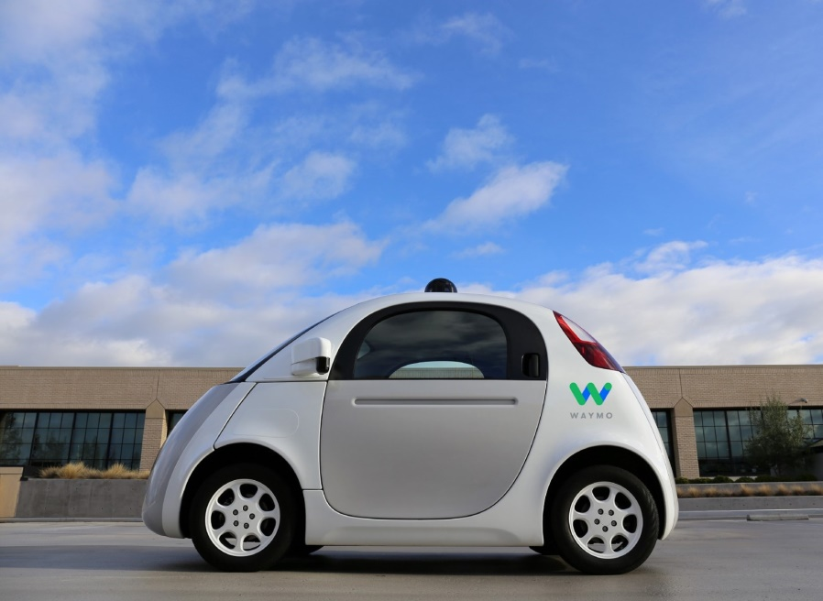
Autonomous Vehicles
For the longest time, self-driving cars have been a buzzword in the AI industry. The development of autonomous vehicles will definitely revolutionaries the transport system. Companies like Waymo conducted several test drives in Phoenix before deploying their first AI-based public ride-hailing service. The AI system collects data from the vehicles radar, cameras, GPS, and cloud services to produce control signals that operate the vehicle.

Slide 35
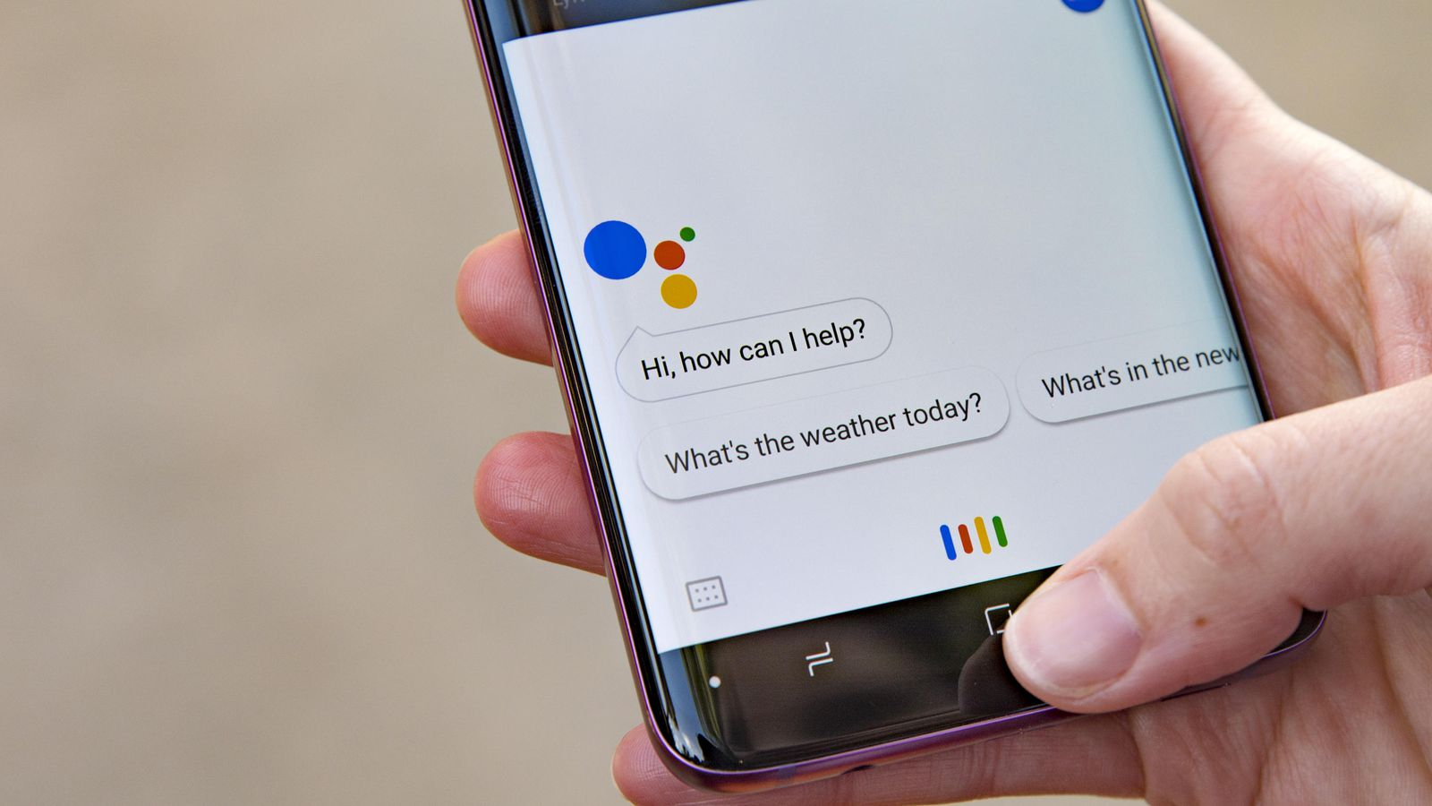
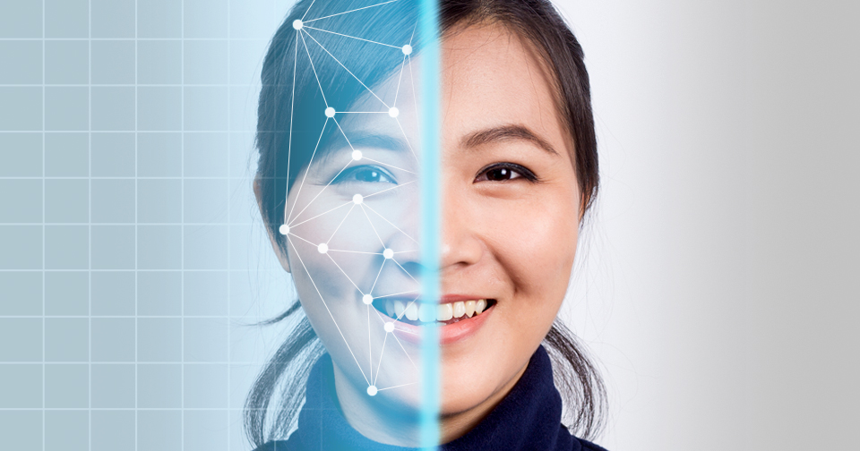
Chatbots & Social Media

Slide 36
Thank you..

